Slide 1
FCI E-campus
Supervised by
Dr. Mohammed Nassef
TA. Nora Abdelhamid
Implemented by
20140169 | Abdulaziz Mahmoud Abdulaziz
2nd Student ID | Abdelrahman Mahmoud
3rd Student ID | Amr Magdy
4th Student ID | Ahmed Abdelmohsen
20140170 | Abdallah Abdelazim Abdallah

Slide 2
Project idea
FCI E-campus: Timetable & Materials Organizer.
Our app helps students stay organized by providing them with their schedule, depending on what courses they have registered.
It also notifies them for new announcements, upcoming quizzes and assignments deliveries to help them keep track with their courses.
The app will organize downloading and uploading materials.
That’s not it, the app will provide a forum for the students to communicate with each other.
And many, many more.

Slide 3
Project idea
Domain of interest: Software Engineering.

Slide 4
Problem significance
What is the Problem we are going to solve?
Students are dispersed between many places: E-comm, Facebook, Acadox, Gdrive, …
Students lose grades, by losing track of assignments, quizzes & materials.
No easy way of communication between students & Teachers (professors & TAs)
Notes:
Dispersed: مشتت

Slide 5
FCI E-campus
No more Facebook
No more Acadox
No more mess

Slide 6
System Analysis and Design: System architecture
Our system uses Service-Oriented Architecture (SOA).
RESTful Web Services provided by the backend for the front-end clients
Notes:
A service is a discrete unit of functionality that can be accessed remotely and acted upon and updated independently, such as retrieving a credit card statement online.

Slide 7
System Analysis and Design: Stakeholders
Students at FCI
FCI professors, TAs, Administration.
Notes:
Stakeholder: a person with an interest or concern in something, especially a business.

Slide 8
System Analysis and Design: Functional Requirements
The app will allow each student, professor and TA to own an account but everyone has special permissions and capabilities in the system. Students don’t need to be verified but teachers do.
A Schedule with courses lectures, labs and sections each student has according to his registered courses. This schedule shows the user what he/she has at every slot of the day (like lecture, lab, section or delivering assignments and tasks or exams).
A static map for the faculty which guides the students by showing the buildings and the location of each lecture/section hall as well as professors’ offices, TAs’ office, the library, the mosque, the restaurant, etc…

Slide 9
System Analysis and Design: Functional Requirements
For each course the student is registered in there will be a resources screen which includes the materials for this course.
Teachers & the moderator students can upload materials to other students in their courses.
Allow Professors & TAs to add tasks to the courses they are assigned to. These tasks can be assignments, lab tasks, quizzes, etc... Each task will have a due date. These tasks appear on students’ schedules & students will receive a notification when a new task is added.
The app will have an Announcements Screen to inform students with any new announcements made by the Admin. Relating to the faculty in general, not to a specific course.

Slide 10
System Analysis and Design: Functional Requirements
Each course will have a Q/A Forum. The course students can post in the course forum to ask a question (related to this course) and other students, professors and TAs can answer.
EXTRA STUFF:
Tasks can be set to require students to upload their solutions. Students need to upload their solutions before due date.
Students will get notifications regularly to remind them of their tasks that has a near due date.
The app will allow users (professors, students or TAs) to send direct private messages to any other user.

Slide 11
System Analysis and Design: Non-functional Requirements

Slide 12
System Analysis and Design: Use-case Diagram

Slide 13
System Analysis and Design: Sample Use-cases

Slide 14
System Analysis and Design: Class Diagram

Slide 15
System Analysis and Design: Sequence Diagram

Slide 16
System Analysis and Design: ERD

Slide 17
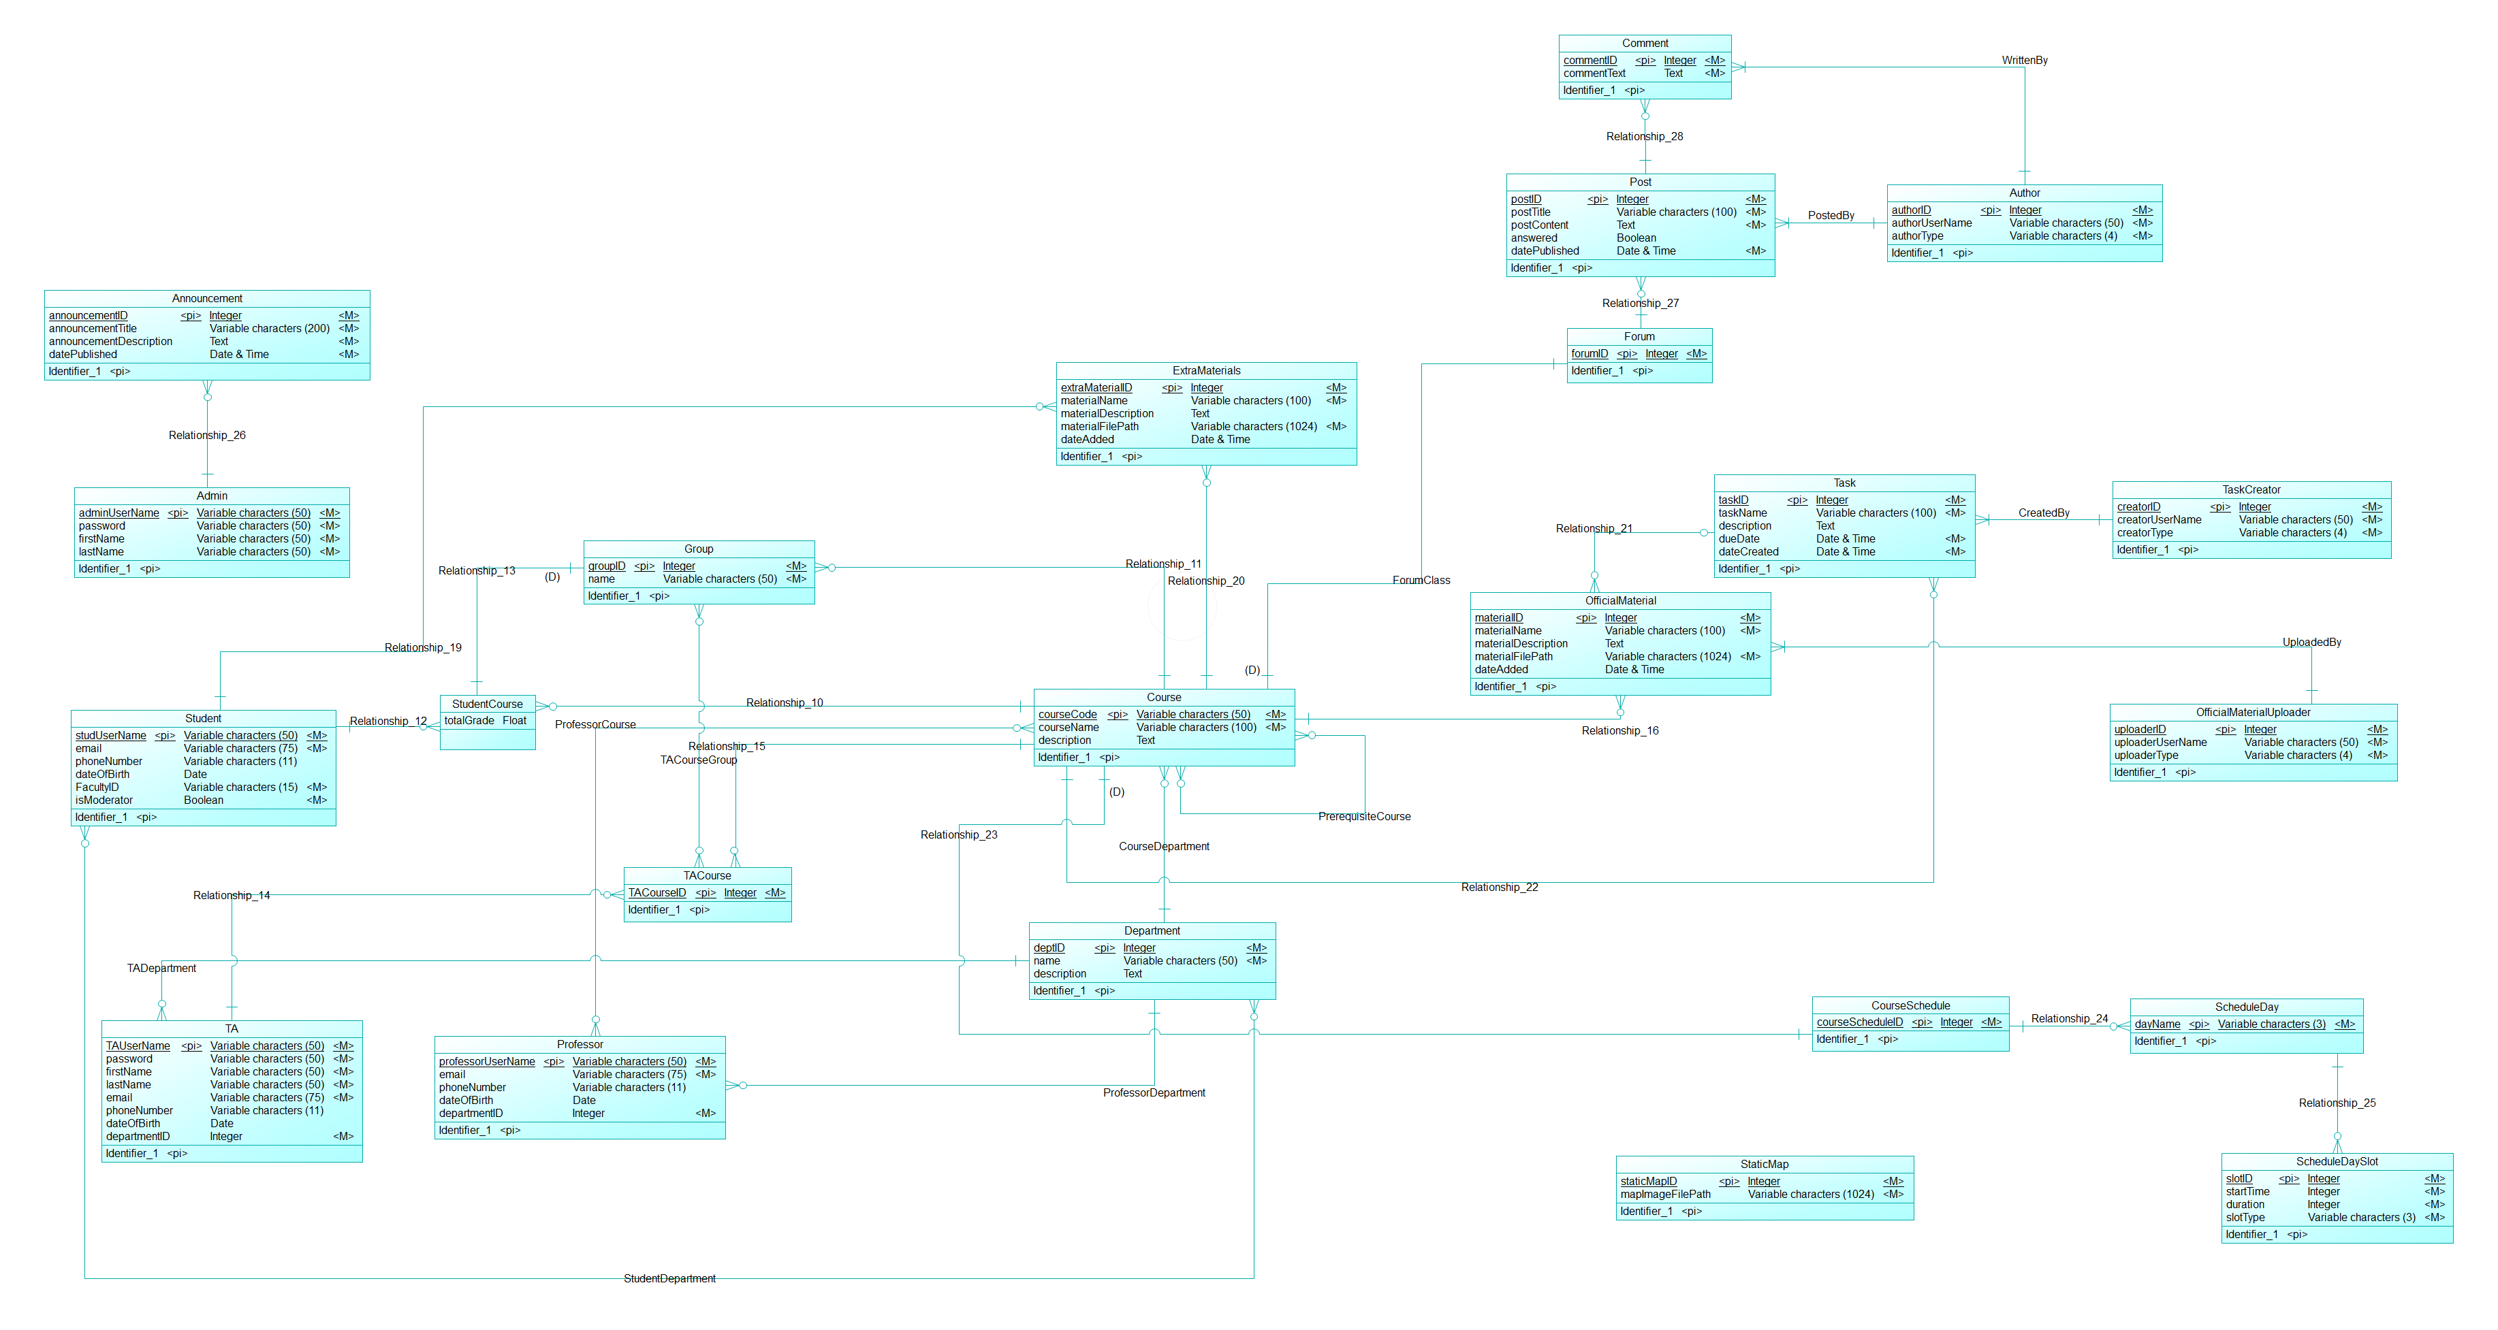
Conceptual Data Model

Slide 18
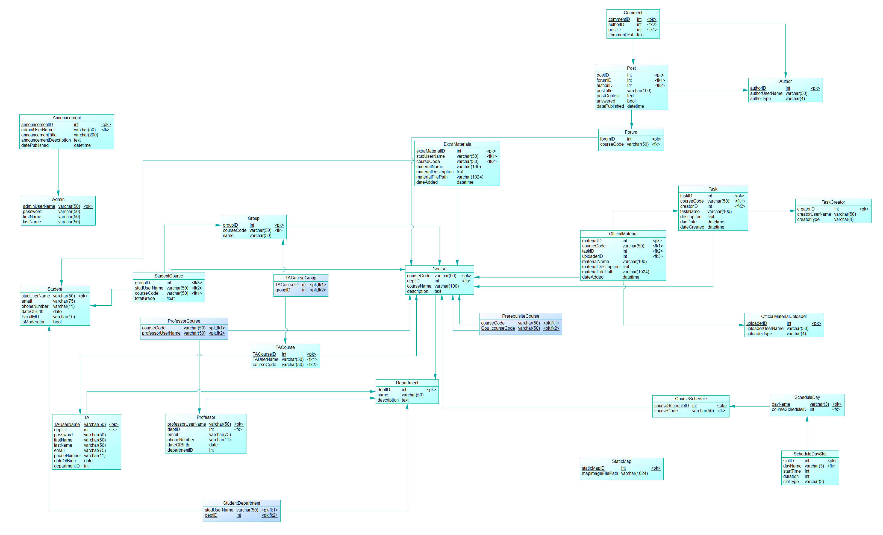
Physical Data Model

Slide 19
Draft of screenshots of expected system screens

Slide 20
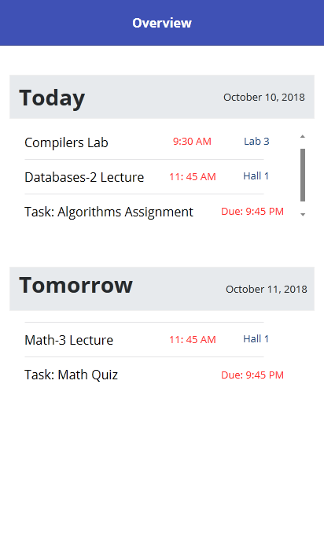
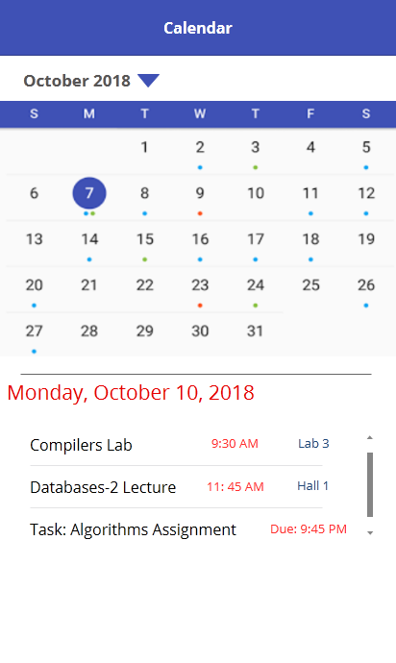
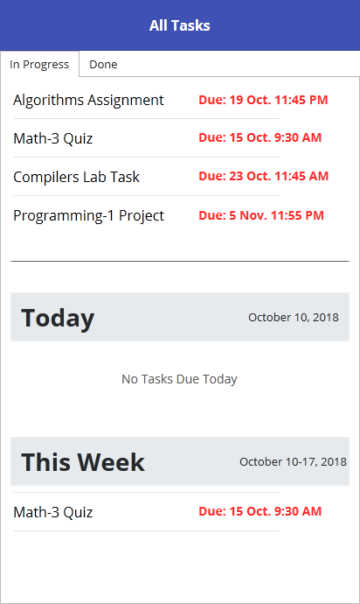

Slide 21
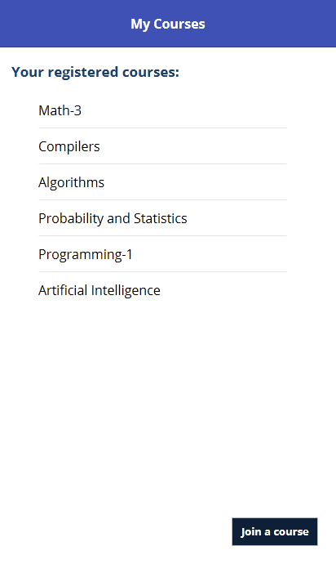
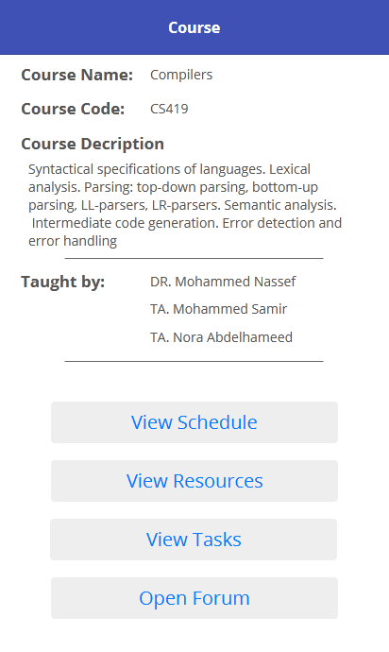
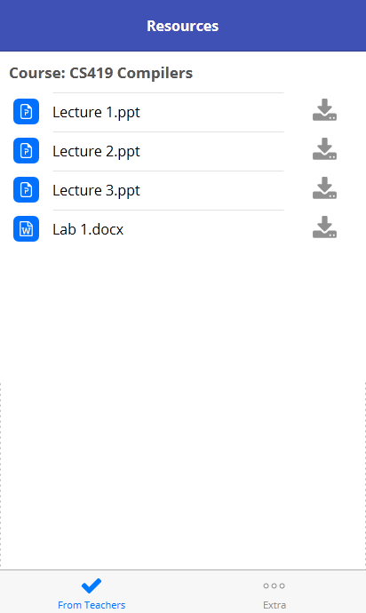

Slide 22
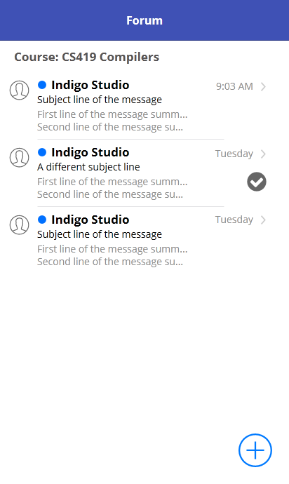
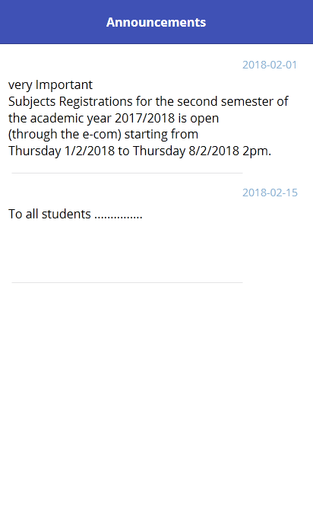
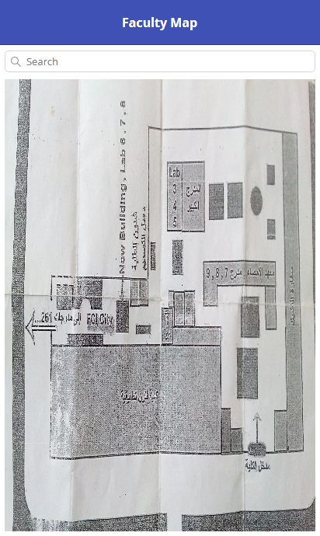

Slide 23
Time Plan
For the tasks fulfilled in previous 4 months
For the tasks to be fulfilled in the next 4 Months

Slide 24
Conclusion

